Slide 1
Back to School Night
SEMINAR
2020-21
Notes:
Teachers may use the entire presentation or engage students in discussion at the initial Way of the SCOTS slide.

Slide 2
Purpose:
Students and teachers work together to master study skills, collaborative skills, and to learn about the
“Way of the SCOTS”.
Throughout the school year, the students will engage in a variety topics:
all with the intent to encourage student success at McFadden Intermediate School.
SCOTS RISE
School Expectations
AVID WICOR strategies
Social Emotional Topics
Counseling Topics

Slide 3
McFadden’s Schoolwide Expectations
All members of the McFadden community are expected to follow “the way of the SCOTS”
SELF CONTROL
CONSIDERATION
OPTIMISM
TENACITY
SOCIAL INTELLIGENCE

Slide 4
Expectations during Distance Learning
ATTENDANCE
Log in a few minutes before class
Be in camera view, as appropriate
Wear appropriate clothing
PARTICIPATION:
Be focused
Be attentive
Show respect
Stay on topic
Speak clearly
PREPARATION:
iPad is charged
Find a quiet space
Check your surroundings
COMMUNICATION
Mute yourself, especially when others are speaking
Raise your hand to speak
Email teachers if you have a question or connectivity issues

Slide 5
School-wide Expectation:
All students are expected to use template
“Last Name, First Name” for identification purposes.

Slide 7
How parents can help at home:
Help at Home
Morning Routines
Make sure iPad is charged
Make sure they are visiting teacher office hours and communicating regularly with teachers
Make sure to check Parentsquare often

Slide 8
How parents get involved?
During distance learning, the best way to get involved is to attend our virtual parent meetings and assisting your children by setting up a learning environment at home.
Make sure to schedule family time to make sure their social emotional health is positive.

Slide 9
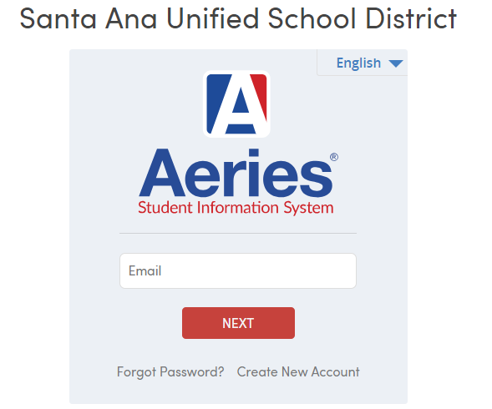
Aeries: Parent Portal
Connecting and communicating with parents is a primary goal at SAUSD. The portal provides details on items such as student attendance, grades, and test scores.
*1st grading period ends Friday, Sept 18th
Report card grades will be available on
Aeries Wednesday, Sept. 23rd
Example - student login
Email: 6 digit student ID @sausdlearns.net
Password: 8 digit birthday
Link to SAUSD parent portal

Slide 10
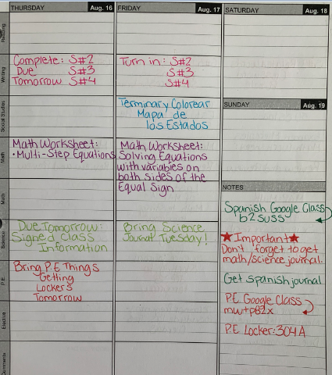
How parents can help at home:
Regularly check binders and backpacks to make sure your student is keeping up with organizational strategies on a daily basis (No loose paper, materials needed are present, assignments are in proper order).
Offer feedback for student so that binder “issues” can be remedied before checks.
Check school Google Classroom or CANVAS
for: homework, due dates, tests, long-term assignments and add family events to the calendar to help students with time management of school work and
fun activities.

Slide 11
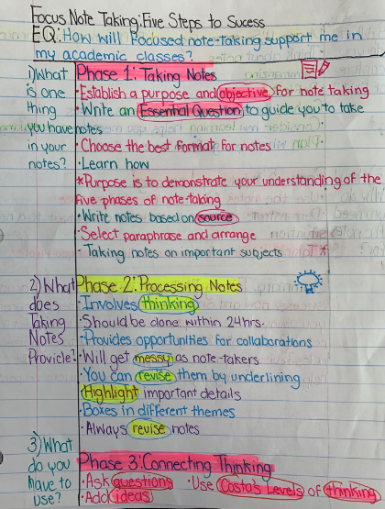
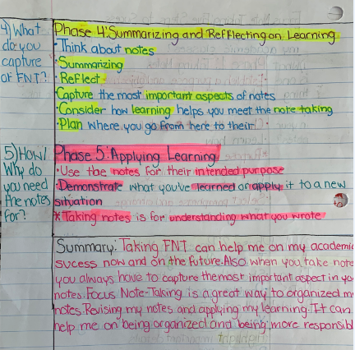
McFadden’s Organizational tools
Organization is an important skill in school, career and other aspects of daily life.
Students throughout the school are expected the have and use
Binder
McFadden Digital Agenda
IPAD
Focused notes
to keep track of their coursework
and to organize their thinking
and learning in all content courses
to support academic success.

